Slide 1


Slide 2


Slide 3
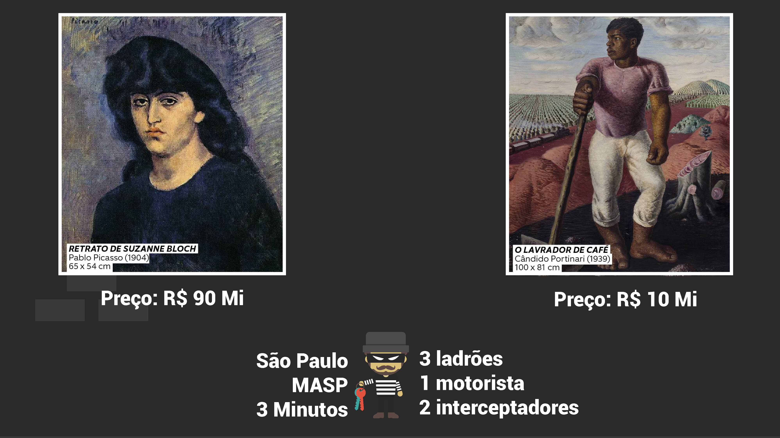

Slide 4
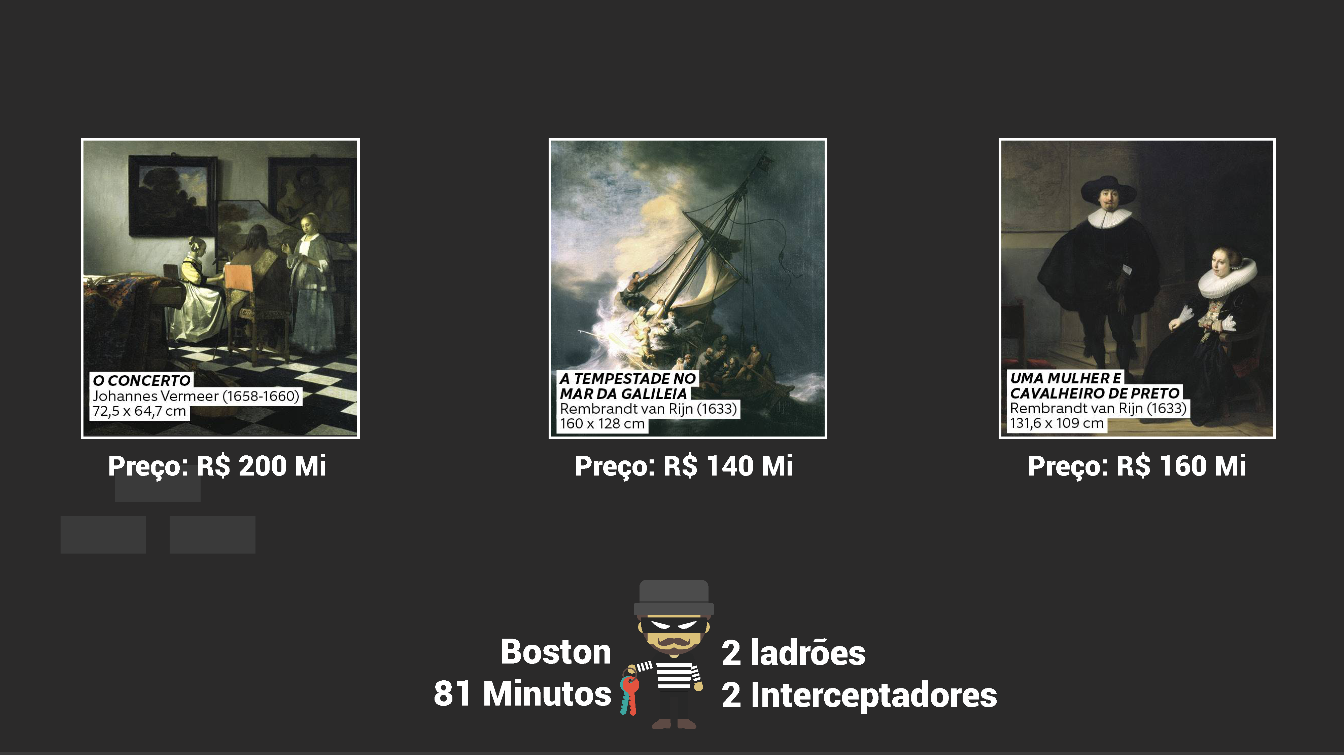

Slide 5


Slide 6


Slide 7

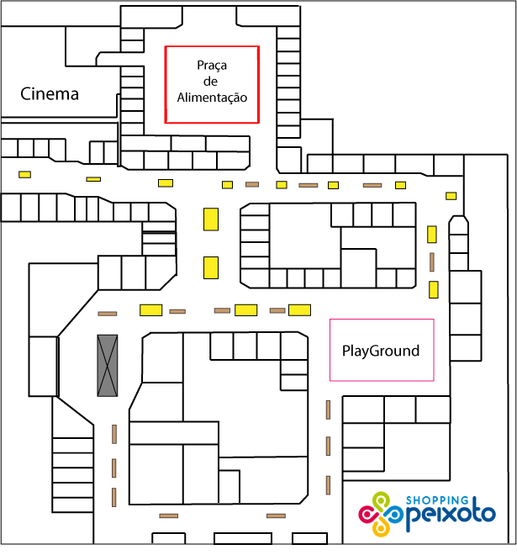


Slide 8
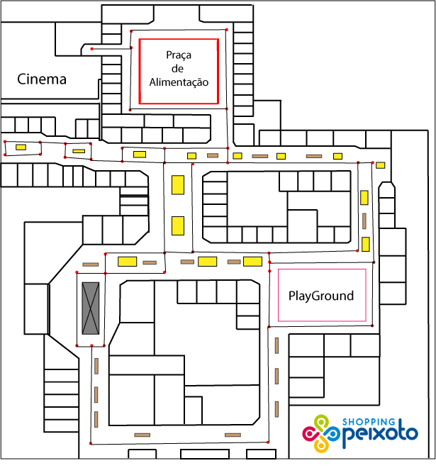

Slide 9


Slide 10


Slide 11
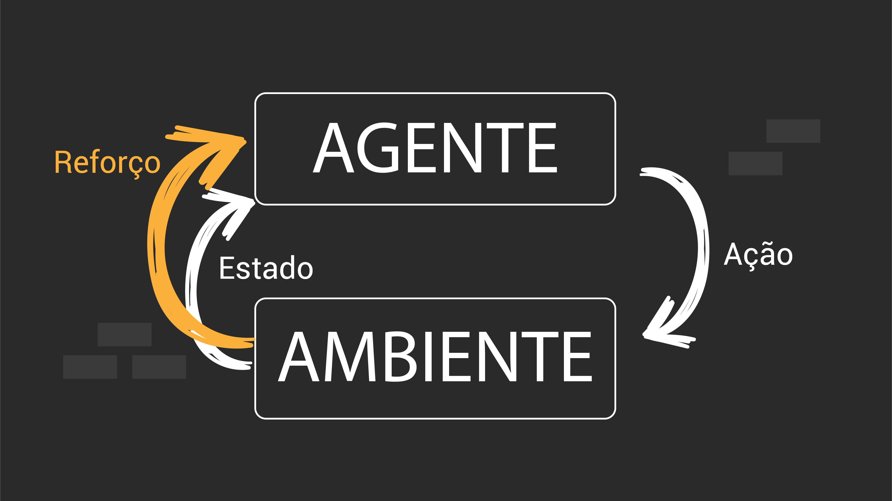

Slide 12
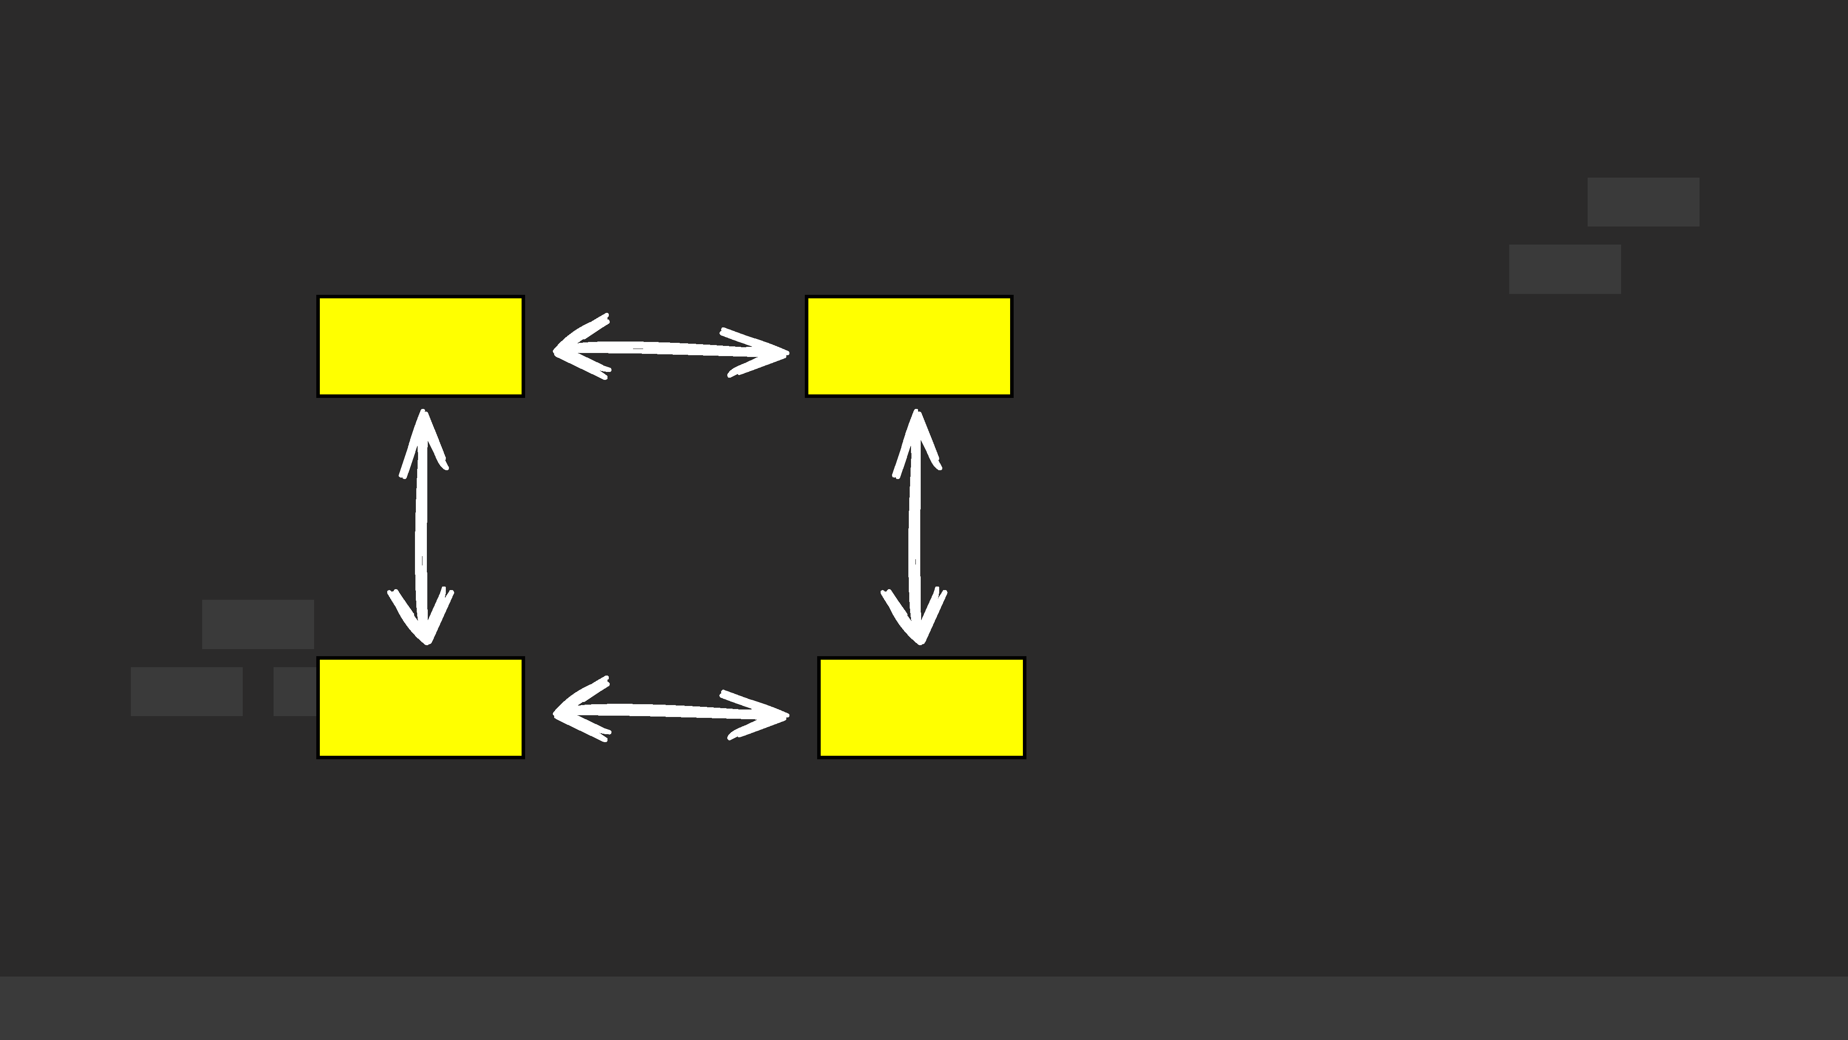

ALGORITMO Q-LEARNING
Chris Watkins

Slide 13


Slide 14
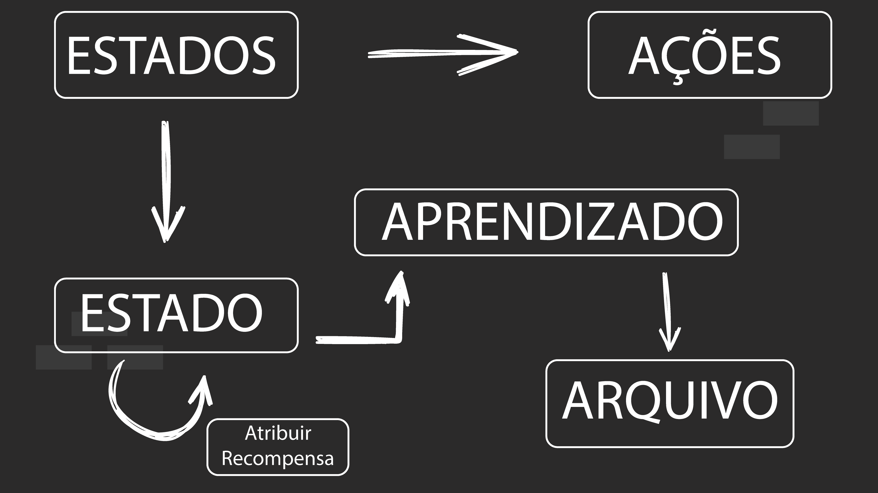

Slide 16

https://github.com/Marcosnto/shopping-peixoto

Slide 17
